Slide 1
Module 2
Compute in the cloud

Slide 2
Outline
1. MODULE 2 INTRODUCTION
  Introduction to Amazon EC2
2. COMPUTE IN THE CLOUD
  Amazon EC2 Instance Types
  How to Provision AWS Resources
  Demo: Launching an Amazon EC2 Instance
  Amazon EC2 Pricing
3. AUTO SCALING AND LOAD BALANCING
  Scaling Amazon EC2
  Directing Traffic with Elastic Load Balancing
  Messaging and Queuing

Slide 3
AWS EC2
Elastic Compute Cloud

Slide 4
Amazon EC2 is a core AWS service that provides scalable virtual servers (called instances) to run applications in the cloud.
Instead of buying and maintaining physical servers, businesses can quickly launch, use, and terminate EC2 instances on demand—making it a flexible, cost-effective alternative to traditional on-premises infrastructure.

Slide 5
Key points
EC2 Instances are virtual machines (VMs) that run on AWS-managed physical servers.
They support both Linux and Windows operating systems and can be configured with custom software.
AWS handles the hardware, hypervisor, and multi-tenancy isolation, while users manage the software and configuration.
EC2 supports vertical scaling, allowing you to increase memory and CPU as needed.
You only pay for running instances, and can scale your compute power based on demand.
Networking controls allow you to define public or private access to your instances.
EC2 makes the well-established concept of virtual machines easier, faster, and cheaper to use through a Compute-as-a-Service model.

Slide 6
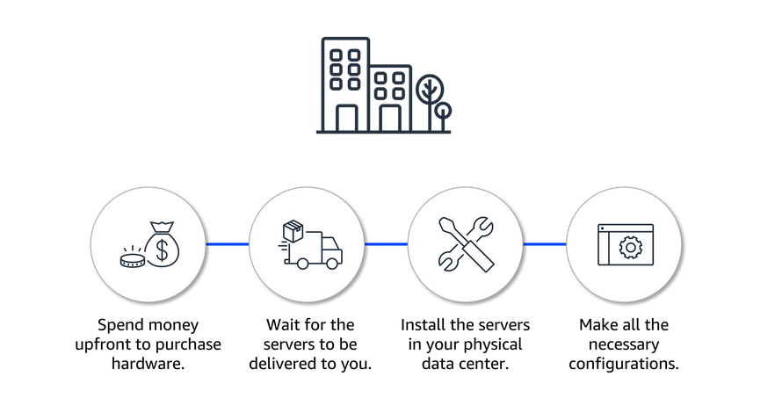
Challenges of on-premises resources

Slide 7
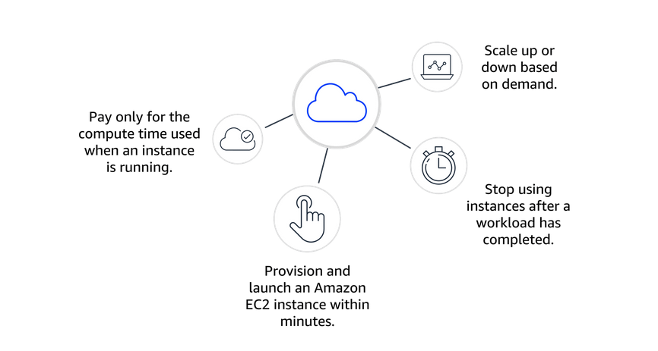
Benefits of using Cloud Resources

Slide 8
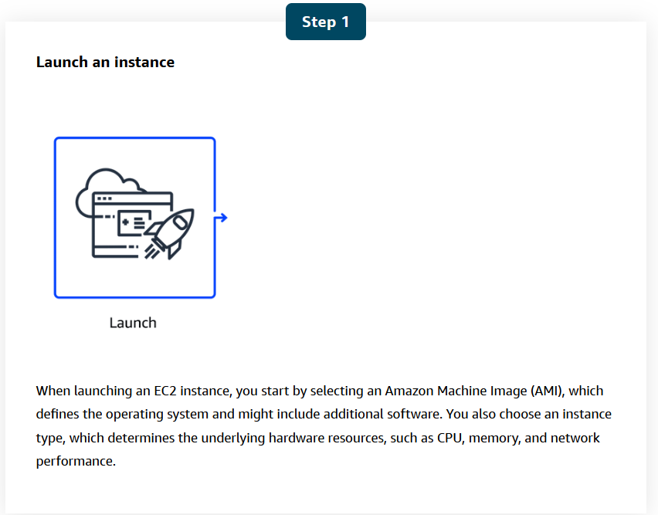
How Amazon EC2 works

Slide 9
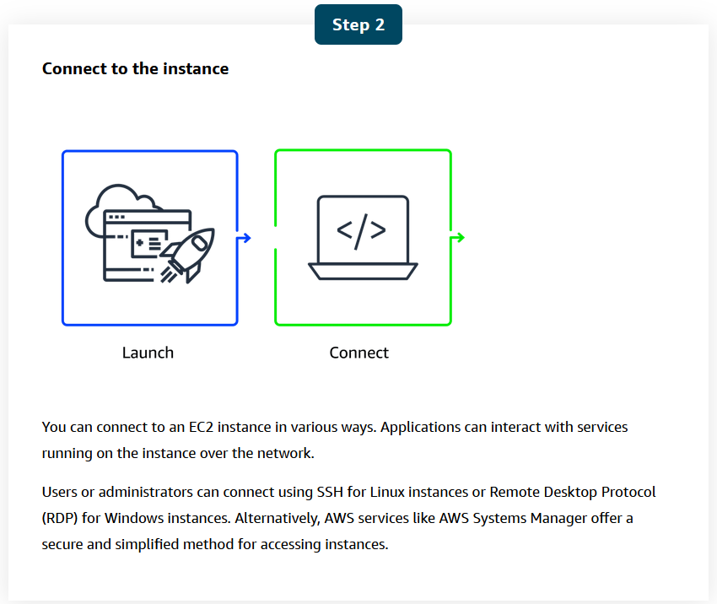
How Amazon EC2 works

Slide 10
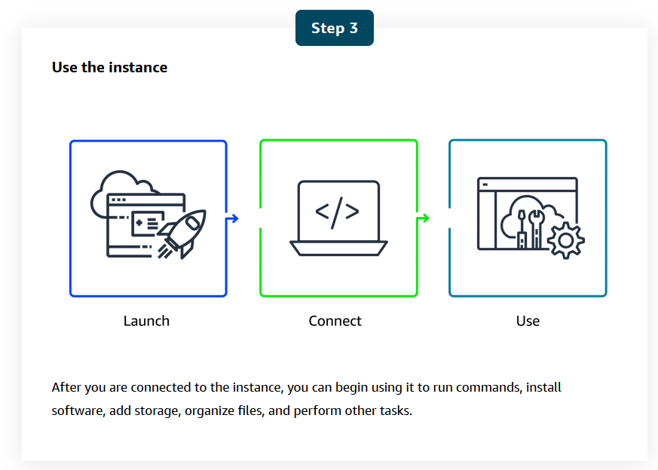
How Amazon EC2 works

Slide 11
Amazon EC2 Instance Types

Slide 12
In this lesson, you will learn:
Explain the different EC2 instance types and their characteristics.
Identify appropriate use cases for each EC2 instance type.

Slide 13
Amazon EC2 offers a broad range of instance types, each tailored to meet specific use case requirements.
These instances come with varying combinations of CPU, memory, storage, and networking capabilities, so you can choose the right mix of resources to optimize performance for your applications.

Slide 14
The main EC2 instance families
General Purpose: Balanced compute, memory, and networking. Great for web apps, development environments, and general workloads.
Compute Optimized: High-performance CPUs (HPC) for tasks like gaming, machine learning inference, or scientific computing.
Memory Optimized: High memory capacity for in-memory databases, real-time big data processing, and caching.
Accelerated Computing: Use specialized hardware (like GPUs or FPGAs) for graphics rendering, AI/ML workloads, and pattern matching.
Storage Optimized: Designed for high-speed, low-latency access to large amounts of data stored locally.

Slide 15
Key takeaway
Once you choose a type, you also select an instance size (e.g., small, medium, large) based on the resources you need and your budget. The larger the instance, the more resources—and the higher the cost.
You can always change your instance type or size as your workload evolves. The cloud makes it easy to adapt and scale, so you only pay for what you need—when you need it.

Slide 16
How to Provision AWS Resources

Slide 17
In this lesson, you will learn:
Explain how to use the AWS Management Console, the AWS Command Line Interface (AWS CLI), and the AWS SDK to interact with AWS services.
Describe the customer and AWS responsibilities regarding virtual machines.
Explain the differences between managed and unmanaged services.

Slide 18
In AWS, tasks such as launching an EC2 instance, stopping an instance, or modifying instance settings are done through API requests.
APIs provide predefined methods to interact with, manage, and configure AWS resources efficiently. In this lesson, you will learn about the three main ways to call AWS APIs.

Slide 19
To work with AWS services, you interact through APIs (Application Programming Interfaces), which allow you to provision, configure, and manage resources. Everything you do in AWS—whether creating an EC2 instance or listing regions—is essentially an API call.

Slide 20
The three main ways to call AWS APIs:
1- AWS Management Console (Graphical Interface):
  Browser-based, visual, and user-friendly.
  Ideal for beginners and for tasks like viewing bills, testing, or managing non-technical operations.
  However, it’s manual and error-prone, making it less ideal for automation or repetitive tasks.

Slide 21
2- AWS Command Line Interface (CLI):
  Text-based interface for invoking AWS services through commands.
  Enables automation via scripts, reducing human error.
  Example:
    aws ec2 run-instances - launches a new EC2 instance.
    aws ec2 describe-availability-zones - lists availability zones in a region.
  Can be used in AWS CloudShell, a browser-based terminal with CLI pre-installed.

Slide 22
3- AWS Software Development Kit (SDK):
  Lets you write code in various programming languages (like Python, JavaScript, etc.) to interact with AWS.
  Ideal for programmatic access and integrating AWS into custom applications.
  Example: A Python script using the SDK to list EC2 instances.

Slide 23
Key Takeaway:
Whether you’re using the console, CLI, or SDK, all actions ultimately translate to AWS API calls. For long-term, scalable, and error-free cloud operations, automation using CLI and SDK is recommended.

Slide 24
Compute and shared responsibility
The AWS Shared Responsibility Model outlines the division of duties between the customer and AWS. AWS handles the security of the cloud (hardware and infrastructure), whereas the customer is responsible for security in the cloud (applications, data, and access control).
An unmanaged service like Amazon EC2 requires you to perform all of the necessary security configuration and management tasks. When you deploy an EC2 instance, you are responsible for configuring security, managing the guest operating system (OS), applying updates, and setting up firewalls (security groups). You will learn more about managed and unmanaged services later.

Slide 25
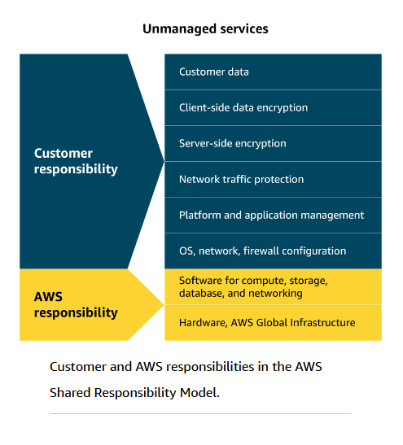

Slide 26
Demo: Launching an Amazon EC2 Instance

Slide 27
In this lesson, you will learn:
Identify the key configurations needed when setting up an EC2 instance.­­
Explain how an Amazon Machine Image (AMI) maintains consistency and efficiency when scaling applications.

Slide 28
Launching an EC2 Instance via the AWS Management Console
Go to the EC2 Console:
Search for "EC2" in the AWS Console and click “Launch Instance.”
Name the Instance:
Give your instance a clear name to identify it later.
Choose an AMI (Amazon Machine Image):
Select an OS template. In this case, the Amazon Linux AMI, which is great for general-purpose web servers.
Choose an Instance Type:
For this demo, t2.micro is selected (1 vCPU, 1 GB RAM)—which is eligible under the Free Tier.
Select or Create a Key Pair:
Key pairs are used for secure SSH access. The public key is stored on the instance, and you keep the private key.

Slide 29
6. Configure Network Settings:
Allow HTTP traffic so the instance can serve web pages publicly.
Configure Storage:
Allocate 8 GB using gp3 EBS (Elastic Block Store) for your instance's disk space.
Add User Data Script:
In the Advanced Details, add a shell script in the User Data section to automatically install and start the Nginx web server at launch.
Launch the Instance:
Click “Launch Instance.” Once it’s running, go to the instance dashboard.
Access the Web Server:
Copy the instance’s public IP address, paste it into a browser, and you should see the Nginx welcome page.

Slide 30
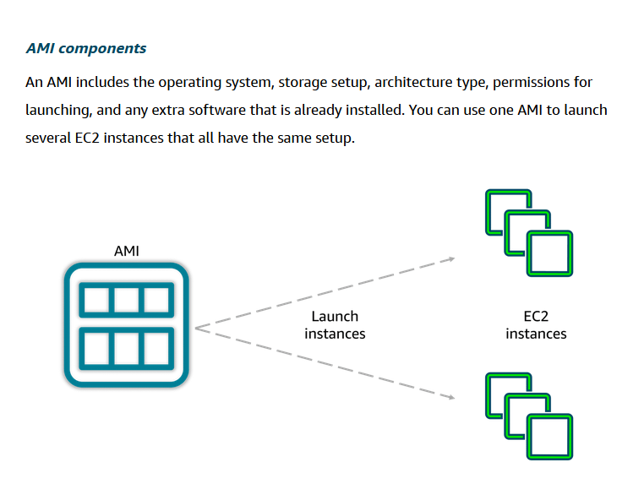

Slide 31
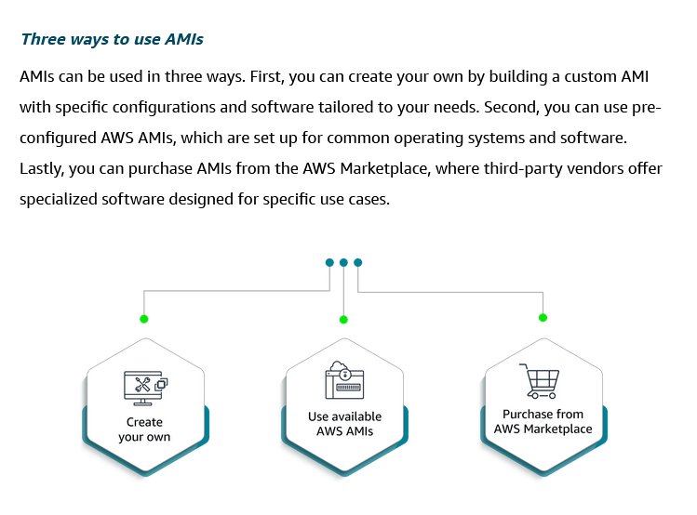

Slide 32
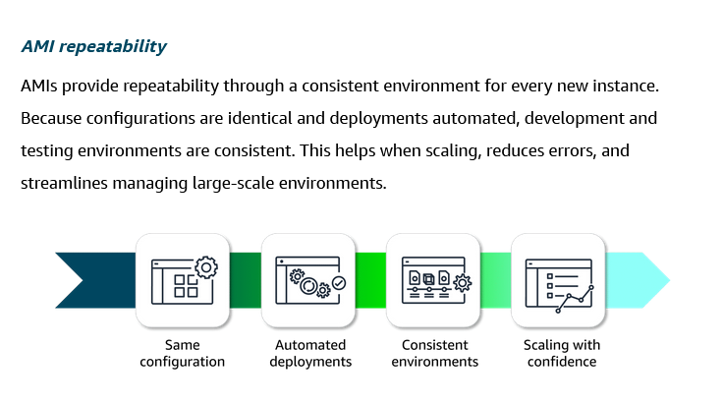

Slide 33
Amazon EC2 Pricing

Slide 34
In this lesson, you will learn
Explain the available Amazon EC2 pricing options.
Describe when to use each pricing option based on specific use cases.
Describe Amazon EC2 Capacity Reservations and Reserved Instance (RI) flexibility.

Slide 35
Amazon EC2 Pricing Options
AWS offers flexible EC2 pricing models to help you balance cost, performance, and workload needs. Here’s a breakdown of the main options:
1. On-Demand
  Pay-as-you-go pricing.
  Billed by hour or second, depending on instance type.
  No long-term commitments.
  Best for:
    Testing
    Short-term or unpredictable workloads
    Beginners exploring AWS

Slide 36
2. Savings Plans
  Commit to a consistent usage (measured in $/hour) for 1 or 3 years.
  Save up to 72% off On-Demand pricing.
  Applies to:
    Any EC2 instance (regardless of type or region)
    Also covers AWS Lambda and Fargate usage.
  Great for:
    Users with predictable workloads seeking flexibility.

Slide 37
3. Reserved Instances (RIs)
  Commit to a specific instance type and region for 1 or 3 years.
  Save up to 75% compared to On-Demand.
  Payment options:
    All upfront: You pay the entire amount for the reserved period at the beginning. You won’t be billed monthly.
    Partial upfront: You pay part of the cost up front, and the rest is billed monthly over the term.
    No upfront: You don’t pay anything up front, but are billed monthly throughout the term.
  Ideal for:
    Steady-state or long-term workloads with known requirements.

Slide 38
4. Spot Instances
  Use unused EC2 capacity at up to 90% discount.
  Instance can be interrupted by AWS with a 2-minute warning.
  Suitable for:
    Fault-tolerant or flexible workloads
    Data analysis, batch jobs, CI/CD tasks

Slide 39
5. Dedicated Hosts
  Rent physical servers exclusively for your use.
  Useful for:
    Compliance or licensing constraints (e.g., BYOL for Windows/SQL)
    Workloads needing isolation and dedicated hardware

Slide 40
Dedicated Instances:
  Pay for instances running on hardware dedicated solely to your account.
  This option provides isolation from other AWS customers.

Slide 41
Key Takeaway
EC2 pricing is highly customizable. Start with On-Demand for flexibility, then consider Savings Plans or Reserved Instances as you identify your baseline usage.
For cost-sensitive or special use cases, Spot Instances and Dedicated Hosts provide even more options.

Slide 42
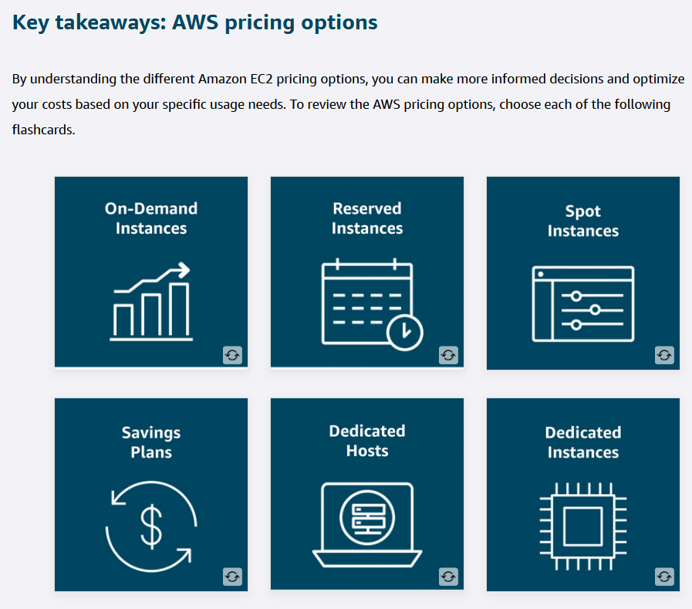

Slide 43
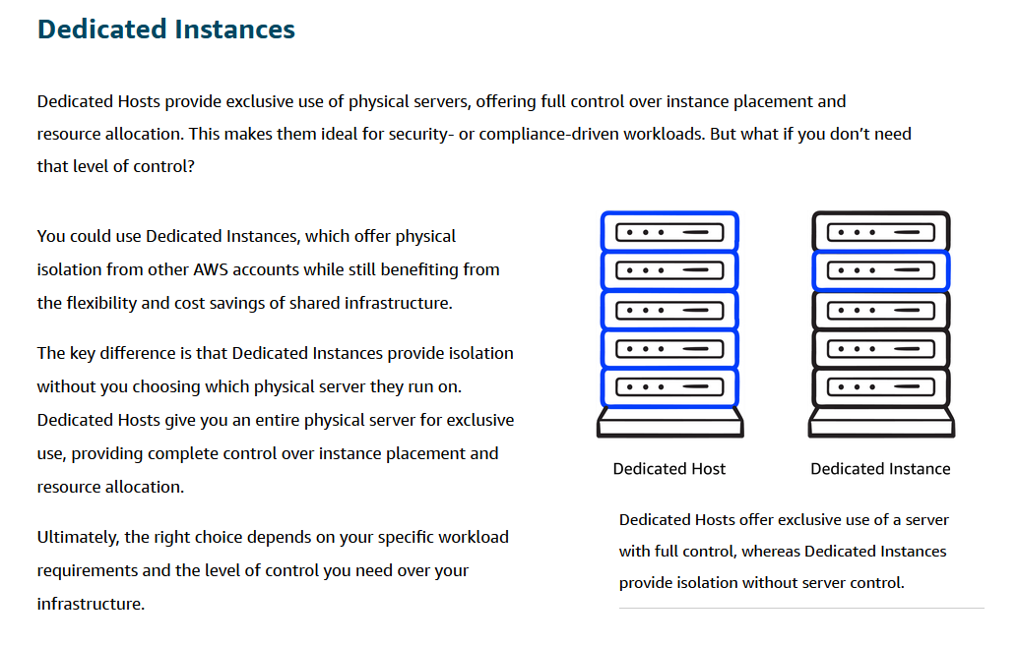

Slide 44
More about cost optimization
To optimize costs and resource allocation, AWS offers a range of pricing options including Savings Plans, Amazon EC2 Capacity Reservations, and Reserved Instances (RIs).
Each of these is tailored to meet different workload and capacity needs.

Slide 45
Scaling Amazon EC2

Slide 46
In this lesson, you will learn:
Recognize the concepts of scalability and elasticity as they apply to AWS.
Describe how AWS can help businesses adjust compute capacity based on varying demands.
  If you've ever tried to access a website that wouldn't load and kept timing out, it might have been overwhelmed by more requests than it could handle. In this lesson, you will explore how scalability helps you manage fluctuating demand by adjusting compute capacity.

Slide 47
Amazon EC2 supports scalability and elasticity, allowing compute capacity to automatically adjust based on business needs.
Instead of over-provisioning for peak usage or risking under-provisioning during demand spikes, AWS enables provisioning resources to match demand in real time.
High availability is achieved by deploying redundant instances across multiple Availability Zones, eliminating single points of failure and ensuring uninterrupted service even if one instance or location experiences issues.
This approach balances performance, reliability, and cost efficiency, ensuring that resources scale up during increased demand and scale down when demand decreases.

Slide 48
Scaling in Amazon EC2
There are two primary ways to handle increased demand in Amazon EC2:
  Scaling Out (Horizontal Scaling): Adding more instances to handle workloads in parallel.
  Scaling Up (Vertical Scaling): Upgrading existing instances to more powerful ones.

Slide 49
Scaling out is often preferred for distributed workloads, as it allows different parts of an application to scale independently. For example, you might increase the number of instances handling requests without necessarily increasing the processing instances if they are not overloaded.
Amazon EC2 Auto Scaling automates this process by adding instances when demand increases and removing them when demand decreases, ensuring the right amount of capacity at all times. This is driven by metrics such as CPU usage, latency, or application-specific indicators.
Amazon CloudWatch is used to collect and monitor these metrics in real time, triggering scaling actions automatically when thresholds are met. This ensures performance consistency, cost efficiency, and the ability to respond instantly to changing workloads.

Slide 50
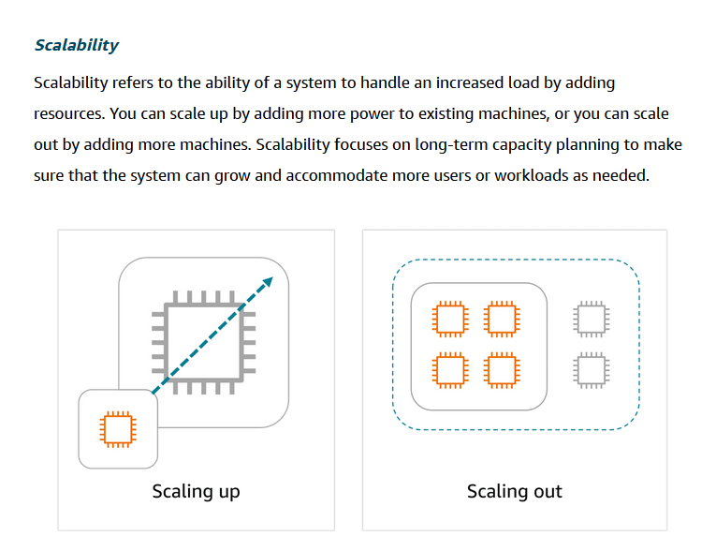

Slide 51
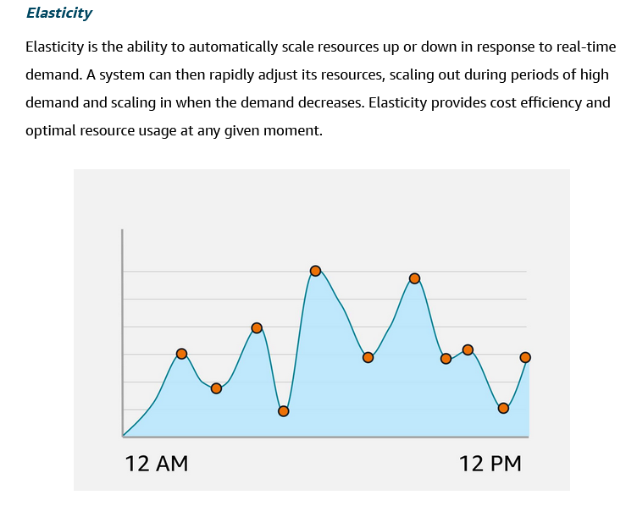

Slide 52
Amazon EC2 Auto Scaling
With EC2 Auto Scaling, you maintain the desired amount of compute capacity for your application by dynamically adjusting the number of EC2 instances based on demand. You can create Auto Scaling groups, which are collections of EC2 instances that can scale in or out to meet your application’s needs.
An Auto Scaling group is configured with the following three key settings.

Slide 53
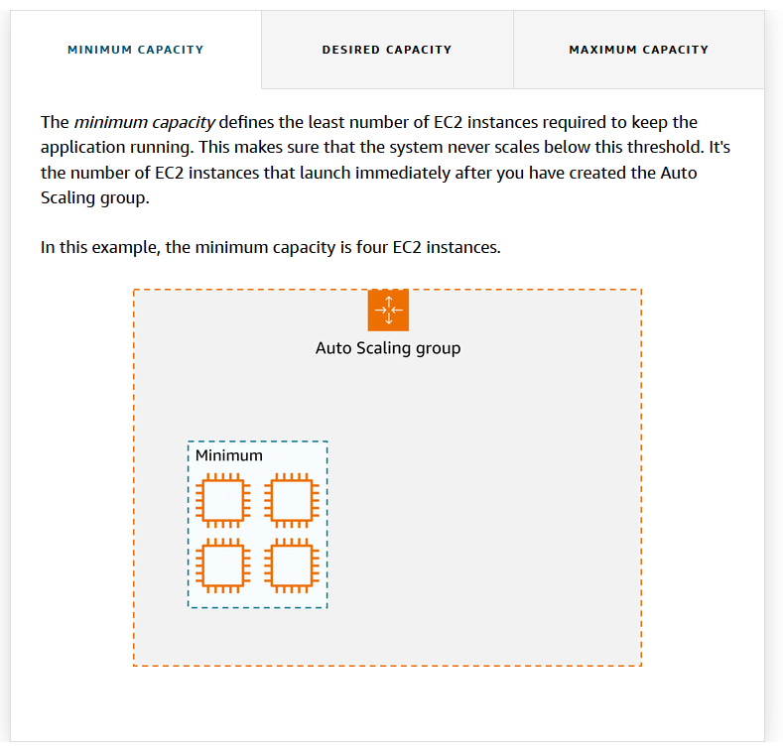

Slide 54
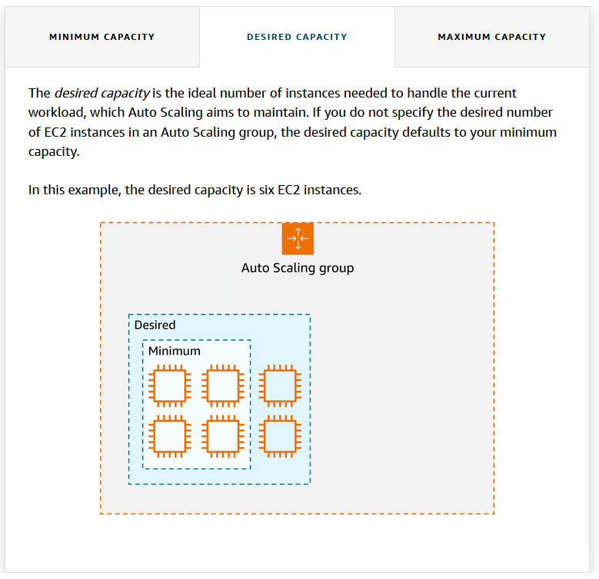

Slide 55
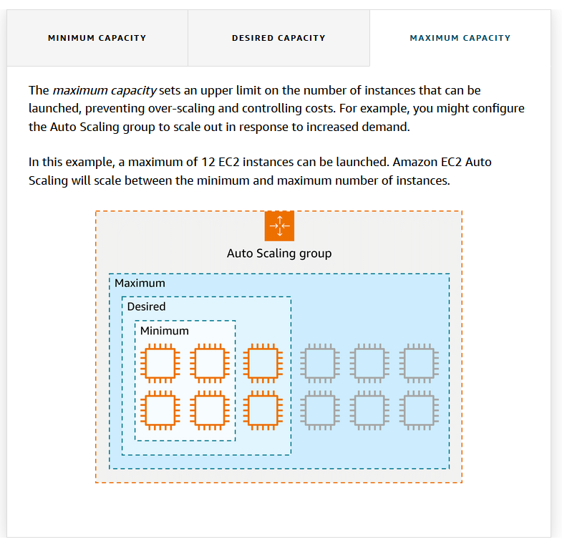

Slide 56
Key takeaways
Scalability is about a system’s potential to grow over time, whereas elasticity is about the dynamic, on-demand adjustment of resources.

Slide 57
Directing Traffic with Elastic Load Balancing (ELB)

Slide 58
In this lesson, you will learn:
Describe the challenge of traffic distribution and scalability in AWS environments.
Recognize the benefits of Elastic Load Balancing (ELB) in AWS.
Explain the relationship between Amazon EC2 Auto Scaling and ELB in managing AWS resources.
  Spreading workloads improves the performance of your applications by preventing any single resource from having to handle the full workload on its own. In this lesson, you will learn how ELB simplifies traffic distribution and management for AWS applications.

Slide 59
While Amazon EC2 Auto Scaling solves the problem of scaling compute resources, distributing incoming traffic evenly across those resources is equally important. This is where load balancing comes into play.
A load balancer ensures that incoming requests are distributed efficiently across multiple EC2 instances. Without a load balancer, some instances may be idle while others are overloaded, leading to inefficient use of resources and inconsistent performance.
Elastic Load Balancing (ELB) is AWS’s managed load balancing service. It automatically distributes network traffic across multiple EC2 instances and scales with traffic demand. ELB supports both internal and external traffic and can apply various routing strategies to improve availability and performance.

Slide 60
A key advantage of ELB is its elasticity—it automatically adjusts to handle varying traffic loads without manual intervention or extra hourly costs. It also removes the complexity of maintaining your own third-party load balancers, as AWS handles scaling, patching, and failover.
In multi-tier applications, ELB simplifies communication between tiers. Instead of having each instance track all others in different tiers, instances communicate with a single ELB endpoint. ELB manages routing traffic to the appropriate backend instance with the fewest active requests.
This decouples system components, making each tier independently scalable and easier to manage.

Slide 61
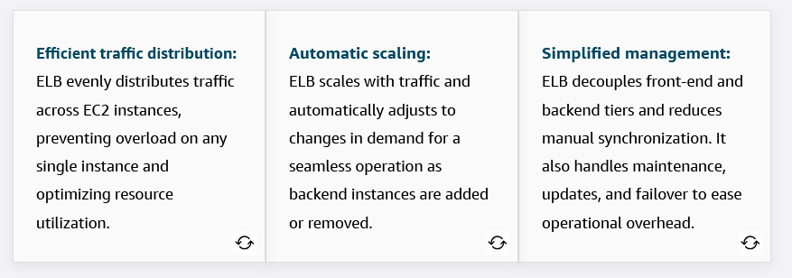
Key takeaways: ELB benefits
Let's review the main benefits of elastic load balancing and how it enhances the performance, scalability, and management of your AWS environment.

Slide 62
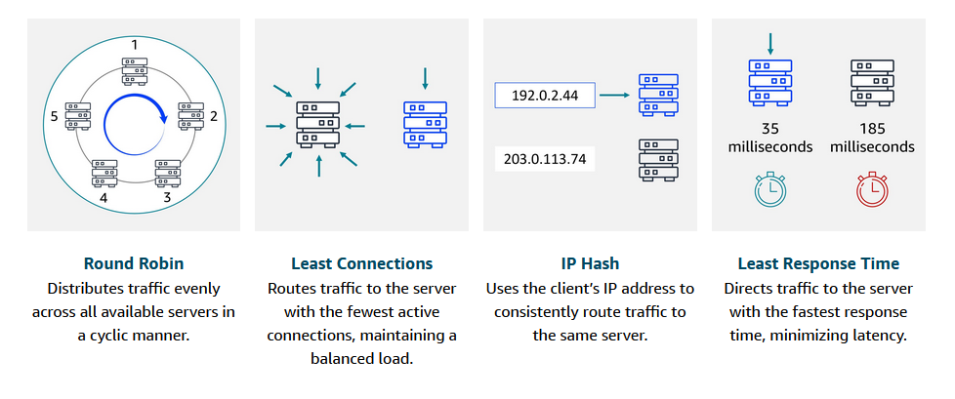
Routing methods
To optimize traffic distribution, ELB uses several routing methods: Round Robin, Least Connections, IP Hash, and Least Response Time. These routing strategies work together for efficient traffic management and optimal application performance.

Slide 63
Example: Elastic Load Balancing
Let's look at an example to better understand how Elastic Load Balancing works in cloud computing. In the healthcare industry, particularly in hospitals and medical facilities that provide online appointment booking systems or patient portals, website traffic can vary greatly throughout the day.

Slide 64
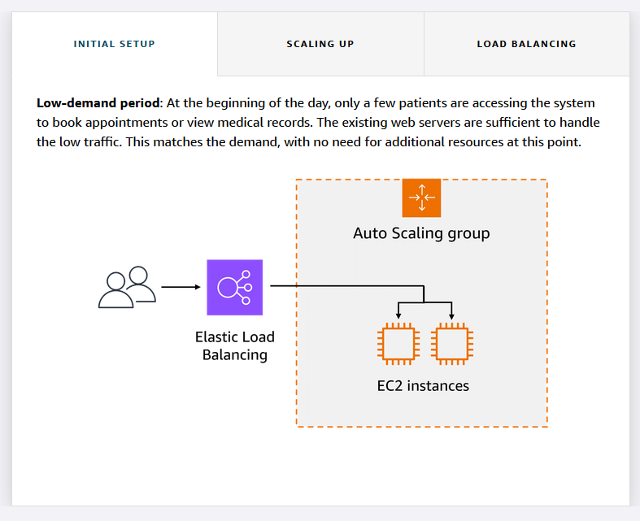

Slide 65
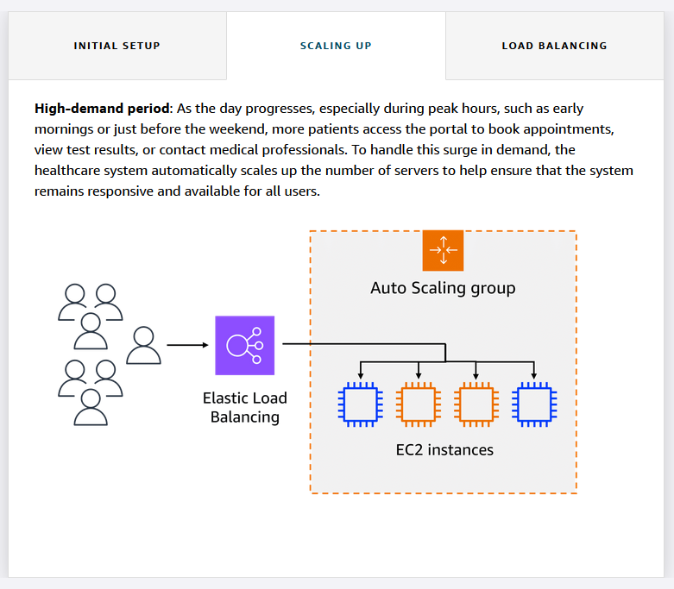

Slide 66
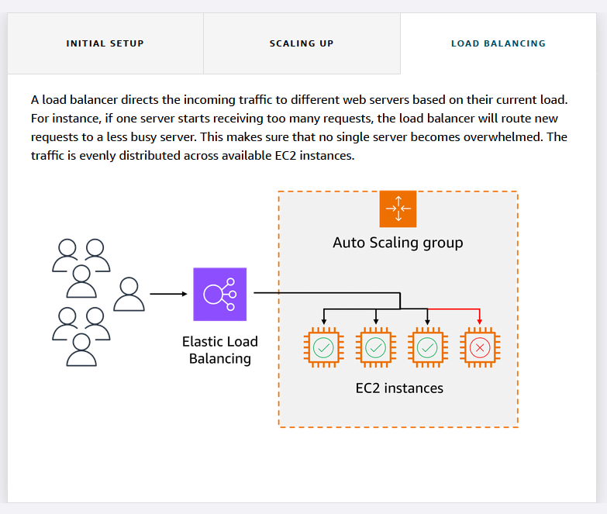

Slide 67
Messaging and Queuing

Slide 68
In this lesson, you will learn:
Describe how Amazon Simple Queue Service (Amazon SQS) facilitates message queuing.
Explain how Amazon Simple Notification Service (Amazon SNS) uses a publish-subscribe model to distribute messages.
Identify the difference between tightly coupled and loosely coupled architectures.
Explain how message queues help improve communication between components.
  Ever wonder how busy coffee shops keep everything running smoothly, even when the barista is on break or the cashier is overwhelmed? Well, the same principles apply to software architecture. In this lesson, you will look into how messaging and queuing help prevent slowdowns and failures.

Slide 69
In modern distributed systems, components often need to communicate reliably and at scale.
If systems are tightly coupled, one component’s failure or delay can negatively impact the others.
To improve reliability and scalability, it's best to use a loosely coupled architecture—where components communicate through message queues or notification systems.
This is where messaging and queuing services come into play in AWS

Slide 70
Amazon Simple Queue Service (SQS)
A fully managed message queuing service that allows applications to send, store, and receive messages at any volume.
Decouples components of an application so that the failure of one does not impact the others.
Messages are stored in a queue until the receiving component is ready to process them.
Provides durability, scalability, and fault tolerance without requiring both sender and receiver to be online at the same time.

Slide 71
Amazon SQS is a message queuing service that facilitates reliable communication between software components.
It can send, store, and receive messages at any scale, making sure messages are not lost and that other services don't need to be available for processing.
In Amazon SQS, an application places messages into a queue, and a user or service retrieves the message, processes it, and then removes it from the queue.

Slide 72
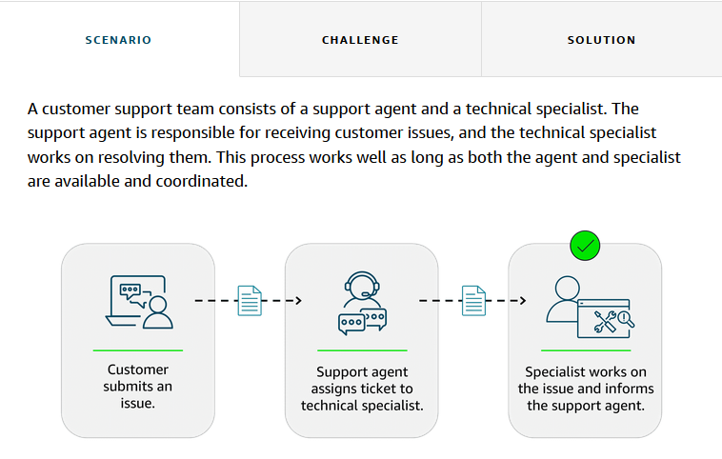
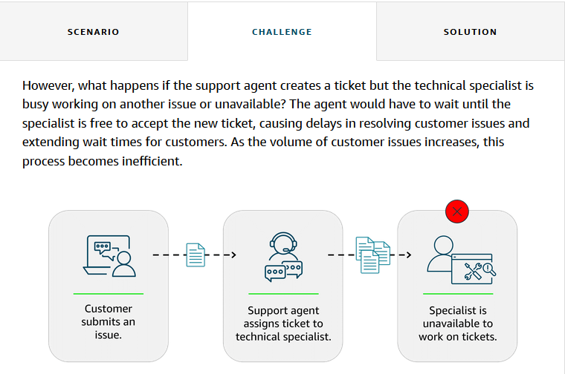
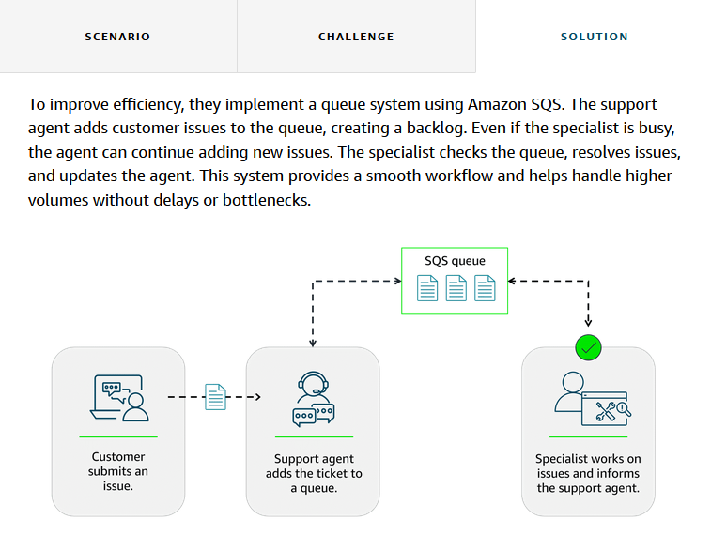
Example: Amazon SQS

Slide 73
Amazon Simple Notification Service (SNS)
A fully managed publish/subscribe messaging service.
Sends notifications in real-time to multiple subscribers, such as applications, mobile devices, SMS, or email.
Unlike SQS, messages are not held—they're delivered immediately to all subscribers.
Useful for sending alerts, real-time updates, or broadcasting messages to multiple systems or users.

Slide 74
Example: Amazon SNS
A company that sells a variety of products is currently sending a single email to all customers with updates on various topics, such as new products, special offers, and upcoming events.
Although this method worked initially, customers want to receive only the updates they’re interested in.
The current email update is causing customer dissatisfaction and lower engagement.

Slide 75
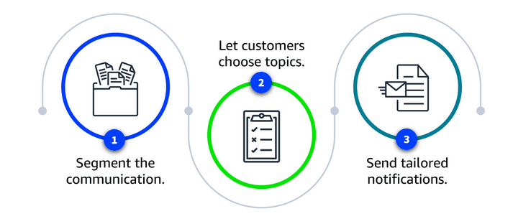

Slide 76
1. Segment the communication
  The company decides to divide the communication into three separate topics, including one for new products, one for special offers, and one for events. Each topic will focus on a specific area of interest.
2. Let customers choose topics
  Customers can subscribe to the topics they care about, such as the following:
  A customer might subscribe only to new product updates.
  Another customer might opt only for event notifications.
  A third customer might choose to subscribe to new product updates and special offers.
3. Send tailored notifications
  With Amazon SNS, the company can send personalized notifications to subscribers based on their specific interests. Amazon SNS makes sure that these notifications are promptly delivered to the right audience, improving the efficiency and relevance of the communication.

Slide 77
Key takeaways
In modern application development, reliability and resilience are important. One effective way to achieve this is by adopting a service-oriented approach.
By using SQS for asynchronous processing and SNS for real-time alerts or fan-out messaging, AWS helps you build scalable, resilient, and loosely coupled applications.

Slide 78
Monolithic applications
Applications consist of multiple components that work together to transmit data, fulfill requests, and keep the application running smoothly.
In a traditional approach to application architecture, the components—such as database logic, web application servers, user interfaces, and business logic—are tightly coupled.
This means that if one component fails, it can cause the failure of other components, potentially bringing down the entire application.

Slide 79
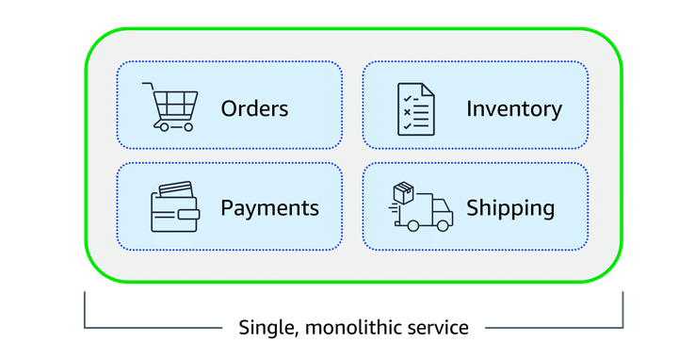

Slide 80
Microservices architecture
To improve application availability and resilience, you can adopt a microservices architecture.
In this approach, application components are loosely coupled, meaning that if one component fails, the others continue to function normally.
The communication between components remains intact, and the failure of a single component does not impact the entire system. This design promotes greater flexibility and reliability in the application.

Slide 81
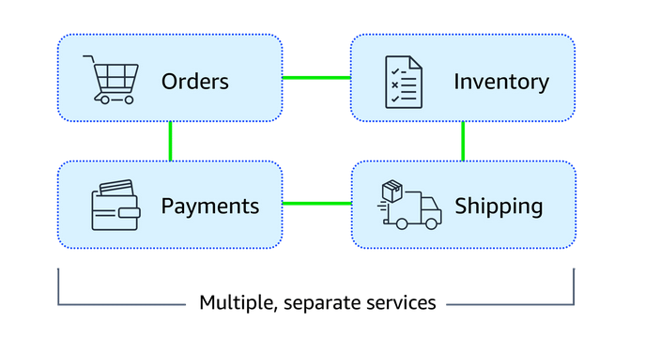

Slide 82
Scalable and reliable cloud communication
Amazon EventBridge, Amazon SNS, and Amazon SQS are AWS services that help different parts of an application communicate effectively in the cloud.
These services support building event-driven and message-based systems.
Together, they help create scalable, reliable applications that can handle high traffic and can enhance communication between components.

Slide 83
EventBridge
EventBridge is a serverless service that helps connect different parts of an application using events, helping to build scalable, event-driven systems.
With EventBridge, you route events from sources like custom apps, AWS services, and third-party software to other applications.
EventBridge simplifies the process of receiving, filtering, transforming, and delivering events, so you can quickly build reliable applications.

Slide 84
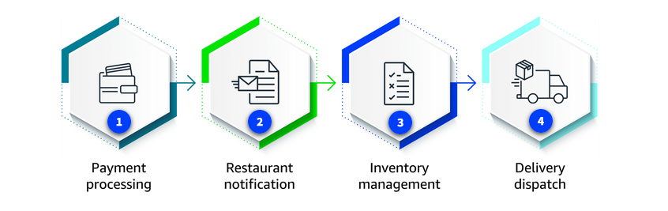
Example: EventBridge
Customers use an online food delivery service to order meals from local restaurants through a mobile app. When a customer places an order, several steps need to happen simultaneously.

Slide 85
1. Payment processing
  The payment service must verify and process the customer's payment.
2. Restaurant notification
  The restaurant receives a notification to start preparing the meal.
3. Inventory management
  The inventory system checks if the ingredients for the order are available.
4. Delivery dispatch
  A delivery driver is notified to pick up and deliver the meal.

Slide 86
How EventBridge helps
EventBridge can route events, like order placed or payment completed, to the relevant services (payment, restaurant, inventory, and delivery).
It can handle high volumes of events during peak times, making sure each service works independently.
Even if one service fails, EventBridge will store the event and process it as soon as the service is available again.
EventBridge helps provide a smooth and reliable operation across the entire system.

Slide 87
Recap
In these lessons about compute, you learned how Amazon EC2 and cloud resources help scale applications.
You gained knowledge of EC2 instance types, pricing options, and how to choose the best instance types for your unique business needs.
You also became familiar with using AWS tools and services like Elastic Load Balancing, Amazon EC2 Auto Scaling, Amazon SQS, and Amazon SNS to manage traffic and communication.

Slide 88
Resources
Resource link | Description
Compute on AWS | This resource provides an overview of the different cloud computing services offered by AWS.
AWS Compute Blog | This blog provides updates, tutorials, and best practices for using AWS compute services, such as Amazon EC2, AWS Lambda, Amazon ECS, and more.
AWS Compute Services | This reference provides an in-depth introduction to the compute services available within the AWS Cloud.
Hands-On Tutorials: Compute | This resource provides practical, step-by-step tutorials designed to help users gain hands-on experience with AWS compute services. It is ideal for beginners and those new to cloud computing.
Amazon EC2 | Amazon EC2 runs virtual servers in the cloud with flexible computing capacity.
Amazon EC2 Instance | This guide provides detailed information about the different types of EC2 instances, including their specifications, capabilities, and use cases. It helps you choose the right instance type based on your workload needs, such as compute, memory, and storage requirements.
Amazon EC2 Pricing | This guide explains the different pricing models for EC2 instances, including On-Demand, Reserved Instances, and Spot Instances, so you can choose the best option based on your usage.
Amazon EC2 Auto | Amazon EC2 Auto Scaling automatically adjusts instance count based on demand for high availability and cost-efficiency.
Elastic Load | Elastic Load Balancing automatically distributes incoming application traffic across multiple EC2 instances for high availability and fault tolerance.
Amazon Simple Notification Service | Amazon SNS is a messaging service for sending notifications to users or other applications through SMS, email, or mobile push notifications.
Amazon Simple Queue Service | Amazon SQS decouples application components through message queuing, storing and processing messages reliably.

